Slide 1
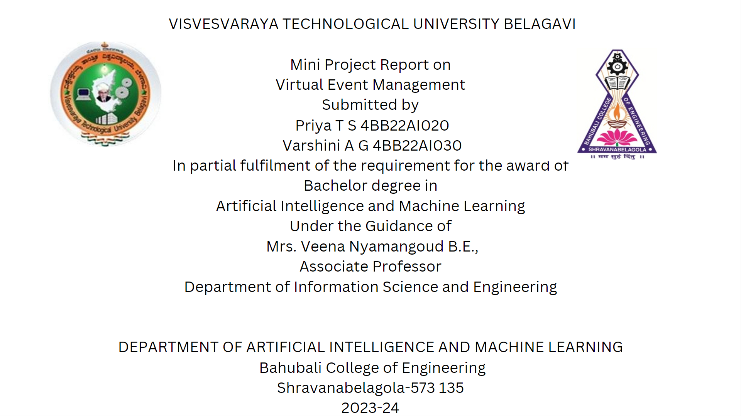



Comprehensive Analysis of Mini Projects
Priya T S Team Member
Priya T S is a dedicated studen† specializing in AI applications. She has contributed significantly to research and development in virtual event management.
A S†udy on Virtual Event Management
Varshini A G Team Member
Vorshini A G possesses expertise in event planning and technology integration. She has played a crucial role in analyzing and implementing strategies for successful virtual events.
Mrs. Veena Nyamagoud, B.E. Guide
Mrs. Veeno Nyamagoud is a knowledgeable lecturer in the Department of Information Science and Engineering. She provides guidance and mentorship to her students, ensuring the successful completion of projects.

Slide 2
Definition of Mini Project
A mini project is a small-scale project for practical application of theoretical knowledge.

Slide 3
VEvent - Virtual Event Management System Overview
Key Features and Benef1ts
Introduction to YEvent
VEvent is a Vir-fual Event Management Sysfem for
strategic online event planning.
Geographical Accessibility
Participants can join events like conferences and workshops from anywhere.
Live Streaming Feature
The platform suppo s live streaming for real-time engagement.
Interactive Sessions
VEvent includes interactive sessions for enhanced participant involvement.
Networking Opportunities
Users can connect and network during events, fostering community.
Advanced Search Functionality
EOsily find even†s through On advanced search feafive tailored to user needs.
Real-Time Interaction
Engage with speakers and other participants during webinars in real-time.
User-FriendlyInterfaee
The platform is designed for seamless navigation and ease of use.

Slide 4





Simplifying Event Organization
Facilitates easier organization and retrieval of event-related memories.
User-Friendly Platform
Designed for individuals and professionals to enhance their productivity.
Setting New Standards
Aims to redef1ne digital memory
rnonogementforevents.

Slide 5
Scope of Virtual Event Management
Overview of Key Features and Opportunities
Diverse Event Types | Allows participation in conferences, workshops, Erode shows, and social gatherings.
Key Features Include Live Streaming | Provides real-time broadcasting of events, ensuring wider audience reach.
Interactive Sessions | Encourages engagement through polls, Q&A sessions, and discussions.
Networking Opportunities | Facilitates connections among participants through virtual meetups.
Scalability and Flexibility | Designed to adapt to fulure enhancements and increased participant numbers.

Slide 6





Project Objectives
Key Goals for Image Management
Efficient Image Organization
Categorize event-related images by event name and date.
DOO
Enhanced Search Functionality
Implement an advanced search algorithm for quick image retrieval.
User-Friendly Interface
Design an intuitive interface for all technical skill levels.
Local Data Management
Establish a reliable local storage system using JSON format.
•a
Performance Optimization
Ensure smooth operation with large image collections and c

Slide 7


Literature Survey on Virtual Event Management
Exploring platforms and their pros and cons
PeerConnect Overview
A comprehensive platform designed for hosting and managing online events effectively.
@
Virtual Conference Management System
Focuses on electronic conferencing technologies to facilitate seamless virtual interactions.
Intelligent Event Finder
Assists users in discovering suitable events based on their specific preferences and interests.
e
e
Advantages of Virtual Events
Centralized management, cost-effective solutions, and †he ability to reach a global audience.
Disadvantages of Virtual Events
Challenges include technical issues, limited personal interaction, and reliance on stable internet connectivity.

Slide 8
Requirement Specifications Overview
Input and Output Requirements for Events
User Registration Details
Collects username, email, ond password for user accounts.
Event Page Outputs
Displays event pages with images and live streaming options.
Event Organizer Information
Requires event title and type to facilitate organization.
Live Webinar Communication
Users con send messages directly to the event planner.
Personalized Recommendations
Provides tailored evenf suggestions based on user input.
Notification System
Alecs users about event updates and relevant notifications.

Slide 9

System Design Overview
Key Architecture and Design Considerations
o Client-Server ModelArehiteeture
The orchitecture is based on o Client—Server f•1odeI wifh clear separation of responsibilities.
Client S*de’I'eclutologies
The user interface is developed using HTML, CSS. and
JovoScriptforo richuserexperience.
e Server 5*deVuactioqali/
Core functionalities ore implemented using Python with the Flask framework for efficient handling.
0 Data Layer Management
Data is stored in JSON files, ensuring a lightweight format for data interchange.
G Scalability Considerations
The design ensures scalability to handle increasing user demands and data loods ePectively.
e Securit}' Measures
Implementing robust security protocols to protect user data ond system integrity is essential.
e Maidtaloabili/Aspects
Design is structured for moinfoinability, facilitating updates and modifications without disruption.
e Performance Optimization
Performance is optimized to ensure responsive interactions and quick data processing times.
Usobilify is a priorify, ensuring thot users find the interface intuitive and easy to navigate.

Slide 10
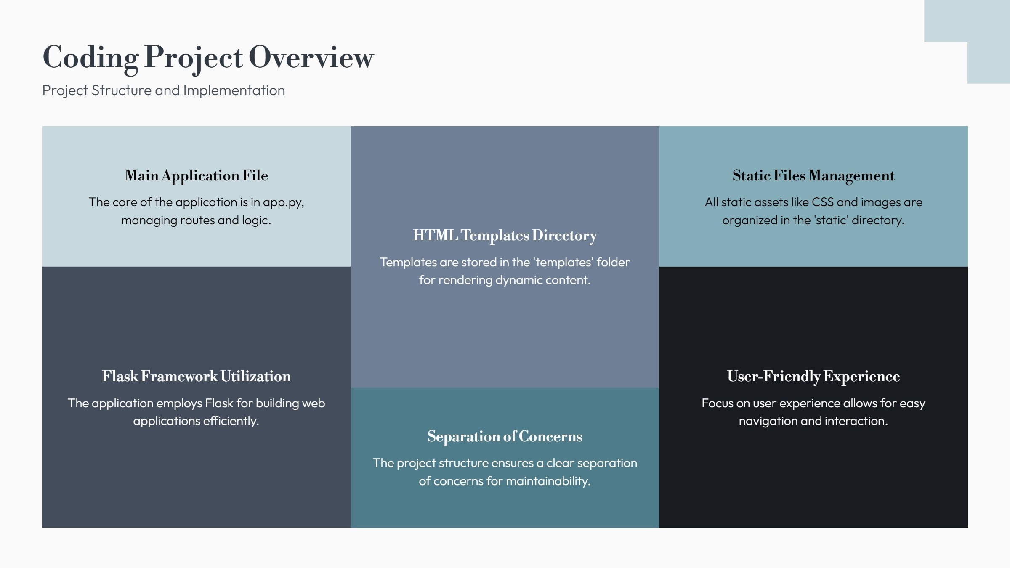

Slide 11

Test Case Examples for System Testing
Overview of testing types and test cases
TCOl | User Registration
TCO2 TCO3 | Login Authentication View Event List | Poss Poss

Slide 12


Seamless Virtual Event Planning
The VEvent platform successfully provides advanced technology for the seamless planning and execution of virtual evenfs.
Enhanced User Experience
It enhances user experience with features like advanced sea rch and facilitates community engagement through webino rs.
Global Participation
The platform broadens event participation without geographical limits, ma king events
accessible to a wider audience.

Slide 13

Conclusion on the VEvent System
Key Insights
Importance ofVEvent System
The VEvent system is crucial for modern virtual events, providing essential tools for organizers.
Advanced Technology Integration
By integrating advanced Technology, VEvent improves the planning and execution of events.
Enhancing CoLaboration
The platform fosters collaboration among participants, enhancing overall engagement.
Engagement and Interaction
VEvent promotes high levels of interaction, making events more engaging for attendees.
Essential for Today's Ecosystem
In today's event ecosystem, VEvent is indispensable for successful virtual experiences.

Slide 14


